Slide 1
Chapter 4
Introducing Classes, Objects and Methods
李晔锋

Slide 2
Key Skills & Concepts
Know the fundamentals of the class
Understand how objects are created
Understand how reference variables are assigned
Create methods, return values, and use parameters
Use the return keyword
Return a value from a method
Add parameters to a method
Utilize constructors
Create parameterized constructors
Understand garbage collection
Use the this keyword
Use Eclipse to construct an entity class

Slide 3
Class Fundamentals
A class is a template that defines the form of an object. It specifies both the data and the code that will operate on that data.
Objects are instances of a class. Thus, a class is essentially a set of plans that specify how to build an object.
Methods and variables that constitute a class are called members of the class. The data members are also referred to as instance variables(实例变量).

Slide 4
The General Form of a Class
class classname{
//declare instance variables
type var1;
type var2;
//…
type varN;
//declare methods
type method1(parameters){
//body of method
}
type method2(parameters){
//body of method
}
//…
type method1(parameters){
//body of method
}
}

Slide 5
The Main Class
A main( ) method is required only if that class is the starting point for your program. Such class is called the Main class(主类).
Also, some types of Java applications don’t require a main( ).

Slide 6
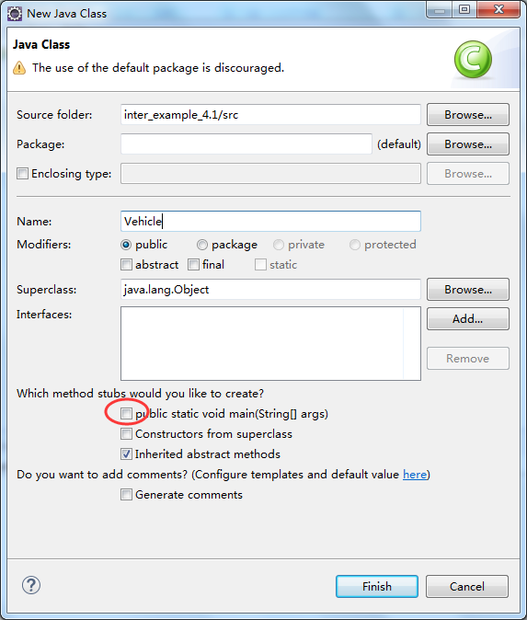
Defining a class
Create a class name “Vehicle” without the main method.

Slide 7
Add Instance Variables
public class Vehicle {
int passengers; //number of passengers
int fuelcap; //fuel capacity in gallons
int mpg; //fuel consumption in miles per gallon
}

Slide 8
How to Use the class
We created the main class called VehicleDemo.
Note: The main class should be in the same folder of the previous class.
public class VehicleDemo {
public static void main(String[] args) {
// TODO Auto-generated method stub
Vehicle minivan = new Vehicle();
int range;
//assign values to fields in minivan
minivan.passengers = 7;
minivan.fuelcap = 16;
minivan.mpg = 21;
//compute the range assuming a full tank of gas
range = minivan.fuelcap * minivan.mpg;
System.out.println("Minivan can carry " + minivan.passengers +
" with a range of " + range);
}
}

Slide 9
The Creation of an Object
In the previous example, an object named minivan is created as follows:
Vehicle minivan = new Vehicle();
The new operator dynamically allocates memory for an object and returns a reference to it. This reference is, essentially, the address in memory of the object allocated by new.
The two steps combined in the proceeding statement can be rewritten like this to show each step individually.
Vehicle minivan;
minivan = new Vehicle();

Slide 10
Access the Members of an Object
After the creation of an object, you can access its instance variables using the dot(.) operator as follows:
minivan.passengers = 7;
minivan.fuelcap = 16;
minivan.mpg = 21;

Slide 11
Two Objects Demo
public class TwoVehicles {
public static void main(String[] args) {
// TODO Auto-generated method stub
Vehicle minivan = new Vehicle();
Vehicle sportscar = new Vehicle();
int range1, range2;
//assign values to fields in minivan
minivan.passengers = 7;
minivan.fuelcap = 16;
minivan.mpg = 21;
//assign values to fields in sportcar
sportscar.passengers = 2;
sportscar.fuelcap = 14;
sportscar.mpg = 12;
//compute the ranges assuming a full tank of gas
range1 = minivan.fuelcap * minivan.mpg;
range2 = sportscar.fuelcap * sportscar.mpg;
System.out.println("Minivan can carry " + minivan.passengers +
" with a range of " + range1);
System.out.println("Sportscar can carry " + sportscar.passengers +
" with a range of " + range2);
}
}

Slide 12
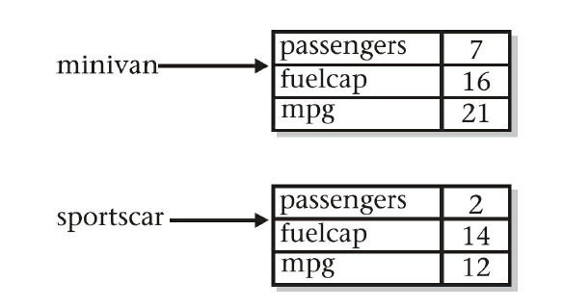
Objects in Memory
The two objects occupy different space in memory respectively. So the modification of one’s instance variable will not affect another.

Slide 13
Reference Variables and Assignment
When you assign one object reference variable to another, you are changing the object that the reference variable refers to.
Vehicle car1 = new Vehicle();
Vehicle car2 = car1;
car1.mpg = 26;
car2
passengers
0
car1
fuelcap
0
26
mpg
0

Slide 14
Methods
The general form of a method
ret-type name(parameter-list){
//body of method
}

Slide 15
Adding a Method to the Vehicle class
public class Vehicle {
int passengers; //number of passengers
int fuelcap; //fuel capacity in gallons
int mpg; //fuel consumption in miles per gallon
//Display the range
void range() {
System.out.println("Range is " + fuelcap * mpg);
}
}

Slide 16
Methods
void range() {
System.out.println("Range is " + fuelcap * mpg);
}
It declares a method called range that has no parameters. Its return type is void. It means that range() does not return a value to the caller.
Inside the range() method, the instance variables fuelcap and mpg are referred to directly, without preceding them an object name or the dot operator.

Slide 17
public class AddMeth {
public static void main(String[] args) {
// TODO Auto-generated method stub
Vehicle minivan = new Vehicle();
Vehicle sportscar = new Vehicle();
//assign values to fields in minivan
minivan.passengers = 7;
minivan.fuelcap = 16;
minivan.mpg = 21;
//assign values to fields in sportcar
sportscar.passengers = 2;
sportscar.fuelcap = 14;
sportscar.mpg = 12;
System.out.print("Minivan can carry " + minivan.passengers + ". ");
minivan.range(); //display range of minivan
System.out.print("Sportscar can carry " + sportscar.passengers + ". ");
sportscar.range(); //display range of sportcar
}
}

Slide 18
Call a method
minivan.range(); //display range of minivan
sportscar.range(); //display range of sportcar
Similar to the access to instance variables, the methods can be called via the dot operation.
Calling the same method from the different objects will return different results.

Slide 19
Returning from a Method
In general, there are two conditions that cause a method to return:
The first is when the method’s closing curly brace is encountered.
The second is when a return statement is executed.
In a void method, you can cause the immediate termination of a method by using a single return.

Slide 20
Returning from a void Method
void myMeth(){
int i;
for(i = 0; i < 10; i++){
if(i == 5) return; //stop at 5
}
}

Slide 21
Returning a Value
Although methods with a return type of void are not rare, most methods will return a value. Methods return a value to the calling routine using this form of return:
return value;
Here, value is the value returned. This form of return can be used only with methods that have a non-void return type. Furthermore, a non-void method must return a value by using this form of return.

Slide 22
Use a return Value
public class Vehicle {
int passengers; //number of passengers
int fuelcap; //fuel capacity in gallons
int mpg; //fuel consumption in miles per gallon
//Return the range
int range() {
return fuelcap * mpg;
}
}

Slide 23
Use the return Value
Notice that range( ) now has a return type of int. This means that it will return an integer value to the caller. The return type of a method is important because the type of data returned by a method must be compatible with the return type specified by the method. Thus, if you want a method to return data of type double, its return type must be type double.

Slide 24
public class RetMeth {
public static void main(String[] args) {
// TODO Auto-generated method stub
Vehicle minivan = new Vehicle();
Vehicle sportscar = new Vehicle();
int range1, range2;
//assign values to fields in minivan
minivan.passengers = 7;
minivan.fuelcap = 16;
minivan.mpg = 21;
//assign values to fields in sportcar
sportscar.passengers = 2;
sportscar.fuelcap = 14;
sportscar.mpg = 12;
//get the ranges
range1 = minivan.range();
range2 = sportscar.range();
System.out.println("Minivan can carry " + minivan.passengers +
" with a range of " + range1);
System.out.println("Sportscar can carry " + sportscar.passengers +
" with a range of " + range2);
}
}

Slide 25
Using Parameters
It is possible to pass one or more values to a method when the method is called.
Recall that a value passed to a method is called an argument. Inside the method, the variable that receives the argument is called a parameter.
Parameters are declared inside the parentheses that follow the method’s name. The parameter declaration syntax is the same as that used for variables.
A parameter is within the scope of its method, and aside from its special task of receiving an argument, it acts like any other local variable.

Slide 26
public class ChkNum {
//return true if x is even
boolean isEven(int x) {
if(x % 2 == 0) return true;
else return false;
}
}
public class ParmDemo {
public static void main(String[] args) {
// TODO Auto-generated method stub
ChkNum e = new ChkNum();
if(e.isEven(10)) System.out.println("10 is even.");
if(e.isEven(9)) System.out.println("9 is even.");
if(e.isEven(8)) System.out.println("8 is even.");
}
}

Slide 27
public class Factor {
boolean isFactor(int a, int b) {
if(b % a == 0) return true;
else return false;
}
}
public class IsFact {
public static void main(String[] args) {
// TODO Auto-generated method stub
Factor x = new Factor();
if(x.isFactor(2, 20)) System.out.println("2 is factor");
if(x.isFactor(3, 20)) System.out.println("this won't be displayed");
}
}

Slide 28
Adding a Parameterized Method to Vehicle
public class Vehicle {
int passengers; //number of passengers
int fuelcap; //fuel capacity in gallons
int mpg; //fuel consumption in miles per gallon
//Return the range
int range() {
return fuelcap * mpg;
}
//Compute fuel needed for a given distance
double fuelneeded(int miles) {
return (double)miles / mpg;
}
}

Slide 29
public class CompFuel {
public static void main(String[] args) {
// TODO Auto-generated method stub
Vehicle minivan = new Vehicle();
Vehicle sportscar = new Vehicle();
double gallons;
int dist = 252;
//assign values to fields in minivan
minivan.passengers = 7;
minivan.fuelcap = 16;
minivan.mpg = 21;
//assign values to fields in sportscar
sportscar.passengers = 2;
sportscar.fuelcap = 14;
sportscar.mpg = 12;
gallons = minivan.fuelneeded(dist);
System.out.println("To go" + dist + " miles minivan needs " +
gallons + " gallons of fuel.");
gallons = sportscar.fuelneeded(dist);
System.out.println("To go" + dist + " miles sportscar needs " +
gallons + " gallons of fuel.");
}
}

Slide 30
Constructors（构造方法）
A constructor initializes an object when it is created.
It has the same name as its class and is syntactically similar to a method.
However, constructors have no explicit return type.
All classes have constructors, whether you define one or not, because Java automatically provides a default constructor.
Non-initialized member variables have their default values,

Slide 31

Constructor Demo
public class MyClass {
int x;
MyClass(){
x = 10;
}
}
public class ConsDemo {
public static void main(String[] args) {
// TODO Auto-generated method stub
MyClass t1 = new MyClass();
MyClass t2 = new MyClass();
System.out.println(t1.x + " " + t2.x);
}
}

Slide 32

A Parameterized Constructor Demo
public class MyClass {
int x;
MyClass(int i){
x = i;
}
}
public class ParmConsDemo {
public static void main(String[] args) {
// TODO Auto-generated method stub
MyClass t1 = new MyClass(10);
MyClass t2 = new MyClass(88);
System.out.println(t1.x + " " + t2.x);
}
}

Slide 33
Adding a Constructor to the Vehicle Class
public class Vehicle {
int passengers; //number of passengers
int fuelcap; //fuel capacity in gallons
int mpg; //fuel consumption in miles per gallon
//This is a constructor for Vehicle.
Vehicle(int p, int f, int m){
passengers = p;
fuelcap = f;
mpg = m;
}
//Return the range
int range() {
return fuelcap * mpg;
}
//Compute fuel needed for a given distance
double fuelneeded(int miles) {
return (double)miles / mpg;
}
}

Slide 34
public class VehConsDemo {
public static void main(String[] args) {
// TODO Auto-generated method stub
//construct complete vehicles
Vehicle minivan = new Vehicle(7,16,21);
Vehicle sportscar = new Vehicle(2,14,12);
double gallons;
int dist = 252;
gallons = minivan.fuelneeded(dist);
System.out.println("To go" + dist + " miles minivan needs " +
gallons + " gallons of fuel.");
gallons = sportscar.fuelneeded(dist);
System.out.println("To go" + dist + " miles sportscar needs " +
gallons + " gallons of fuel.");
}
}

Slide 35
Garbage Collection
Java’s garbage collection system reclaims objects automatically—occurring transparently, behind the scenes, without any programmer intervention.
It works like this: When no references to an object exist, that object is assumed to be no longer needed, and the memory occupied by the object is released. This recycled memory can then be used for a subsequent allocation.

Slide 36
The this Keyword
The this keyword points to the current object reference.
The general form of this keyword is:
this.var
The this keyword is used when a local variable of a method has the same name as the instance variable.

Slide 37

The this Keyword Demo
public class MyClass {
int x; //instance variable
MyClass(){
x = 5;
}
void f1() {
int x = 10, y;
/*local variable has the same
name as instance variable*/
y = this.x + x;
System.out.println(y);
}
void f2(int x) {
int y;
/*parameter has the same
name as instance variable*/
y = this.x + x;
System.out.println(y);
}
}
public class ThisDemo {
public static void main(String[] args) {
// TODO Auto-generated method stub
MyClass my = new MyClass();
my.f1();
my.f2(8);
}
}

Slide 38
The this Keyword Demo
public class Pwr {
double b;
int e;
double val;
Pwr(double b, int e){
this.b = b;
this.e = e;
val = 1;
if(e == 0) return;
for(;e > 0;e --) val = val * b;
}
}

Slide 39
Entity Class (实体类)
Entity class is widely used in practical projects, it contains at least following features:
Several instance variables.
An empty constructor and a parameterized constructor.
The getter and setter methods for the variables.

Slide 40
Example: Construct an Entity Class in Eclipse
First, create the Vehicle class with the following instance variables.
public class Vehicle {
int passengers; //number of passengers
int fuelcap; //fuel capacity in gallons
int mpg; //fuel consumption in miles per gallon
}

Slide 41
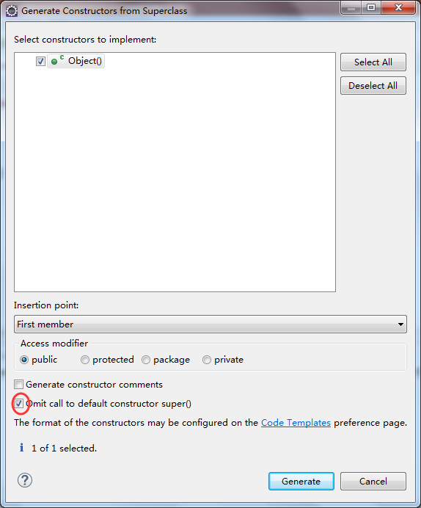
Example: Construct an Entity Class in Eclipse
Next, select “source” → “Generate Constructors from Superclass... and then tick on the “Omit call to default constructor super() ”.

Slide 42
Example: Construct an Entity Class in Eclipse
Then, select “source” → “Generate Constructors using Fields...” also tick on “Omit call to default constructor super() ”.
public class Vehicle {
int passengers; //number of passengers
int fuelcap; //fuel capacity in gallons
int mpg; //fuel consumption in miles per gallon
public Vehicle() {
// TODO Auto-generated constructor stub
}
public Vehicle(int passengers, int fuelcap, int mpg) {
this.passengers = passengers;
this.fuelcap = fuelcap;
this.mpg = mpg;
}
}

Slide 43
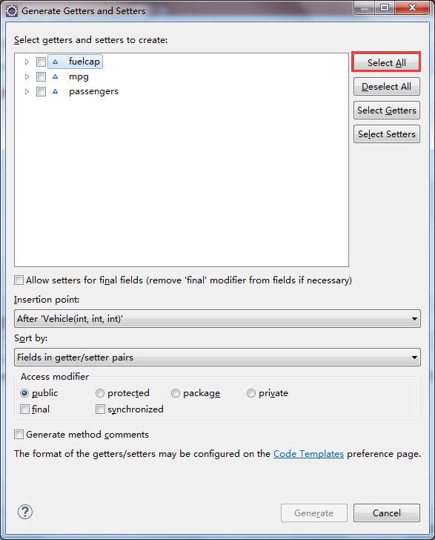
Example: Construct an Entity Class in Eclipse
Finally, generate the getter and setter methods for the instance variables. Select “Source” → “Generate Getters and Setters”, and click “Select All” in the next dialog.

